Slide 1

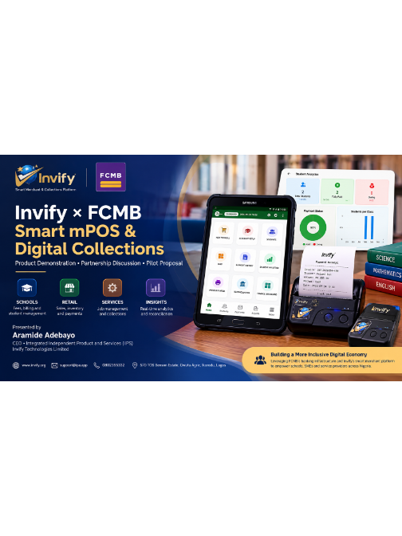


×
FCMB
SPEAKER 1: OLUWELE TEMITOPE • OPENING
Smart mPOS & Digital Collections
Connecting school and merchant operations with FCMB acquiring infrastructure and secure managed hardware.
PLATFORM
HOST COMPANY
TARGET
Invify Technologies
IIPS Limited
FCMB Merchant Acquiring

Slide 2
SPEAKER 1: OLUWELE TEMITOPE
Executive Session Structure
SECTION 01
SECTION 02
SECTION 03
SECTION 04
Foundation & Problem
Product & School Demo
Smart mPOS & Dotroid
Settlement & Ask
Merchant payment disconnect.
Live fee billing workflows.
Hardware and kiosk security.
FCMB acquiring partnership.
Lead: Aramide Adebayo (CEO)
Lead: Saliu Sheriffdeen
Lead: Adekunle Matthew
Lead: Adewunmi & Helen

Slide 3


SPEAKER 2: ARAMIDE ADEBAYO (CEO)
Company Overview & Unified Proposition
Integrated Systems (IIPS)
Invify Platform
FCMB Partnership Goal
Parent technology development company based in Lagos, engineering commercial payment applications.
End-to-end merchant invoicing, student roster billing, and automated multi-channel payment reconciliation.
Combining bank acquiring infrastructure, TIDs, and settlement rails with our managed counter ecosystem.

Slide 4
SPEAKER 2: ARAMIDE ADEBAYO (CEO)
The Core Merchant Disconnect
Conventional POS Operation
Invify Connected Model
Terminal accepts ₦100,000 without operational metadata.
Payment transaction binds directly to student records.
No Context: Payer identity unknown at counter.
Identity Bound: Linked to student and class term.
No Billing Link: Cannot verify outstanding balances.
Automated Splits: Tuition, books, and uniforms tracked.
Manual Audits: End-of-month paperwork reconciliations.
Instant Settlement: Real-time double-entry ledgers.

Slide 5
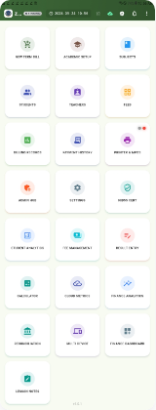
SPEAKER 3: SALIU SHERIFFDEEN
Platform Overview: Connected Modules
Fee & Academic Setup
Class tiers, student registries, and term billing structures.
Smart mPOS & Thermal Printing
Card reader pair, physical receipt issuance, and cash logs.
Reconciliation & NIBSS Cert Hub
Centralized transaction audit trail and compliance gateway.

Slide 6
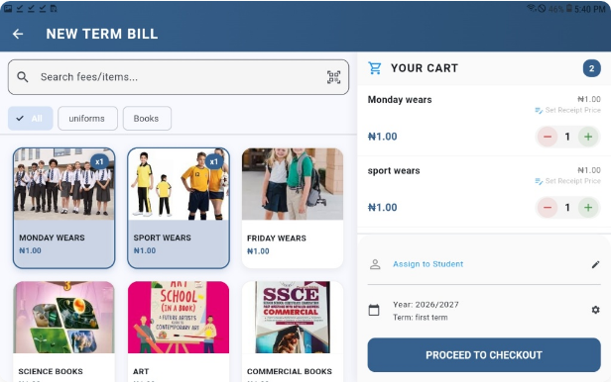
SPEAKER 3: SALIU SHERIFFDEEN
Primary Use Case: Educational Billing
Itemized Cart Management
Tuition, uniforms, textbooks, and extracurriculars in one checkout.
Roster Binding
Instant assignment to registered student or external payer profile.
Custom Discounts & Terms
Multi-child concessions and flexible installment schedules.

Slide 7
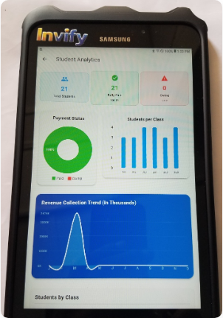
SPEAKER 3: SALIU SHERIFFDEEN
Real-Time Collection Analytics
100%
Zero
Paid Status Rate
Unresolved Deficits
Class Compliance Breakdowns
Immediate visibility into fee collection distributions across junior and senior secondary levels.
Expected vs. Recovered Trends
Real-time tracking of term revenue targets against actual funds cleared.

Slide 8



SPEAKER 3: SALIU SHERIFFDEEN
Beyond Schools: Multi-Sector Scalability
Schools & Academies
Retail & Hospitality
Service Providers
Primary initial deployment target. Seasonal billing, term levies, and roster reconciliation.
Field-tested at Odies Bar, Ikorodu. Quick inventory selection, counter receipts, and shifts.
Artisans and trade workshops. Job quotes converted into immediate card payments.

Slide 9

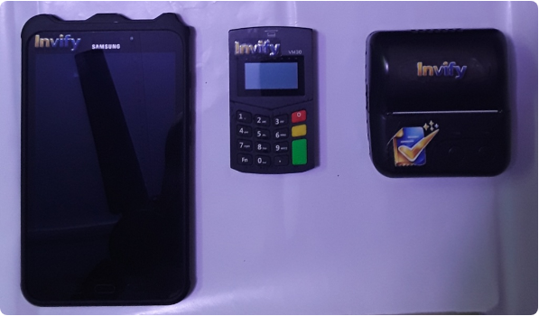
SPEAKER 4: ADEKUNLE MATTHEW
Smart mPOS: Purpose-Built Hardware Kit
Samsung Enterprise Tablet
High-clarity Android touchscreen running full Invify management software.
AISINO VM30 Card Reader
Vanstone Electronic EMV Chip & PIN secure payment terminal.
Fast Thermal Printer
High-speed Bluetooth receipt printing for parent records.

Slide 10
SPEAKER 4: ADEKUNLE MATTHEW
Device Testing & Compatibility
15+
3
v9+
Devices Evaluated
POS Brands Validated
Android OS Support
End-to-end sandbox and field testing completed.
Including AISINO Vanstone electronic architecture.
Broad operating system compatibility across models.
Certification Ready: Software structure prepared for ISO messaging, NIBSS certification, and direct FCMB terminal key injection protocols.

Slide 11
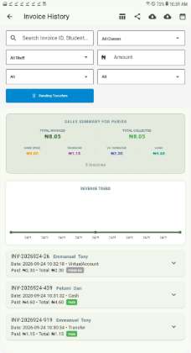
SPEAKER 5: ADEWUNMI ODULEYE
Multi-Channel Payment Verification
Dedicated Virtual Accounts
Instant reconciliation for parents paying through mobile banking apps.
Smart mPOS Card Clearing
Direct debit card processing at counter with immediate authorization.
Automated Requery & Cash Match
Resolves pending transfers instantly, keeping accounting balanced.

Slide 12
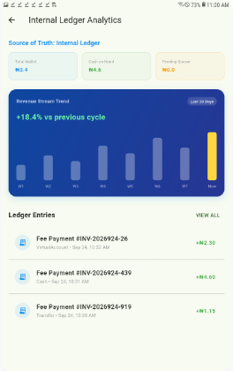
SPEAKER 5: ADEWUNMI ODULEYE
Single Source of Truth: Internal Ledger
Double-Entry Ledger Tracking
Every fee payment automatically splits across wallet balances, cash reserves, and acquiring channels.
Real-Time Margin Auditing
Real-time tracking of transaction fees, MSC shares, and merchant disbursements with zero ambiguity.

Slide 13
SPEAKER 5: ADEWUNMI ODULEYE
Six-Step Settlement Lifecycle
01
02
03
04
05
06
Create Bill
Link Roster
Card / VA
Acquiring
Settlement
Auto-Match
Invoice assembled on Invify.
Student ID bound to transaction.
Customer executes payment.
FCMB rails process payment.
Funds settle in merchant account.
Invify reconciles student ledger.

Slide 14


SPEAKER 4: ADEKUNLE MATTHEW
Dotroid: Security & Managed Device Layer
Kiosk & Launcher Control
Fleet Heartbeat & Telemetry
Remote Lock & Wipe
Locks tablet strictly to business apps. Blocks browsing, unauthorized APKs, and tamper hazards.
Monitors battery status, software versions, network connectivity, and terminal health.
Instant geo-location tracking and cryptographic key de-provisioning upon terminal theft or risk.

Slide 15
SPEAKER 4: ADEKUNLE MATTHEW
Why the Tablet + Dedicated mPOS Model?
Enhanced Ergonomics
Isolated Cryptography
Cost-Effective Scaling
Conventional POS touchscreens are too cramped for multi-student tuition rosters, complex invoices, and detailed analytics. Tablets offer operational comfort.
Card PIN entry stays strictly on the AISINO VM30 hardware reader. Plaintext credentials never touch the host tablet, simplifying PCI-DSS boundaries.
Replacing a damaged screen does not require discarding certified acquiring hardware, drastically lowering long-term maintenance costs.

Slide 16
SPEAKER 6: OKAFOR HELEN
Target Market Opportunity
Private Education
Retail & Merchants
Artisans & Trades
Tier 1 Priority
Tier 2 Priority
Tier 3 Priority
Over 18,000 registered private schools across Lagos and Ogun State alone seeking automated term collections.
Bars, pharmacies, and mid-sized distributors needing inventory tied directly to bank card terminals.
Mechanic hubs and fabrication workshops upgrading from personal bank transfers to formal invoices.

Slide 17
SPEAKER 6: OKAFOR HELEN
Commercial Revenue Model
REVENUE 01
REVENUE 02
REVENUE 03
REVENUE 04
Monthly SaaS
Hardware Kit
Acquiring Share
Enterprise SLA
Subscription per merchant for student portal and Dotroid MDM.
Outright lease or sale of tablet, AISINO mPOS, and printer bundle.
Revenue split with FCMB on processed card transaction volumes.
Custom ERP integration and on-site support for school chains.

Slide 18
SPEAKER 6: OKAFOR HELEN
Strategic Alignment with FCMB
What FCMB Delivers
What Invify Delivers
Regulated acquiring rails & settlement.
Sticky low-cost deposit growth for FCMB.
Terminal Identification (TID & MID).
Specialized school and merchant software.
Commercial merchant settlement accounts.
Zero terminal dormancy via business workflows.
Payment certification & compliance backing.
Managed fleet security via Dotroid MDM.

Slide 19
SPEAKER 6: OKAFOR HELEN
Controlled Merchant Pilot Plan
PHASE 01
PHASE 02
PHASE 03
PHASE 04
PHASE 05
Alignment
Integration
Key Injection
Field Pilot
Commercial Scale
Architecture, APIs, and TID parameters.
Connect Invify to FCMB card acquiring switch.
Certify AISINO VM30 security keys.
Deploy 15–20 units to selected schools.
Review settlement metrics & expand.

Slide 20
SPEAKER 6: OKAFOR HELEN
Execution Request to FCMB
01
02
03
Acquiring Rails
Switch APIs
Hardware Certification
MID and TID provisioning for Invify Smart mPOS deployments across pilot schools.
Direct API/SDK hooks for transaction authorization, requery endpoints, and webhooks.
Terminal key-injection and certification path for the AISINO VM30 device suite.

Slide 21
SPEAKER 6: OKAFOR HELEN
Presenting Team
Oluwele Temitope
Aramide Adebayo
Saliu Sheriffdeen
Opening & Partnerships
Chief Executive Officer
Product Engineering
Strategic positioning and executive dialogue.
Vision, product architecture, and IIPS lead.
Software workflows and school billing lead.
Adekunle Matthew
Adewunmi Oduleye
Okafor Helen
Hardware & Dotroid MDM
Payments & Settlement
Commercial Strategy
Terminal integration and security layers.
Financial flows, ledgers, and reconciliation.
Market scaling and commercial partnerships.

Slide 22


THANK YOU • FCMB PARTNERSHIP SESSION
Let's Power Modern Merchant Collections
Ready to proceed with live hardware demonstrations and technical workstream alignment.
www.invify.org
support@iipa.app
0802355332
Ikorodu, Lagos

